Slide 1
Agenda
Project Overview:
topic and motivation for selecting this topic.
Project goals: Questions the team hopes to answer.
Description of the source of data
Data exploration & transformation
Project analysis
Final Project outcome , Dashboard and visualization
Technologies, languages, tools, and algorithms used throughout the project
Recommendation for future analysis

Slide 2
Project Overview
Motivation:
Housing prices are a hot topic, especially During the COVID-19 Pandemic (Leading to increased demand for housing).
Team members are passionate about Real Estate investment and would like to Build Machine Learning Model to help House Owners and Real Estate Investors to evaluate the Potentials of a Housing deals in California.
Project overview:
We will import housing sale records from CSV formats to Python, then we will use Python Libraries and SQL to perform ETL process on the raw data. Once Data is Loaded we build a supervised Linear regression and Neural network MLs to predict the housing prices.
Project goals: Questions the team hopes to answer:
Predict the Average housing prices and Help the Consumers and Real Estate investors to make educated decisions based on Data analytics.

Slide 3
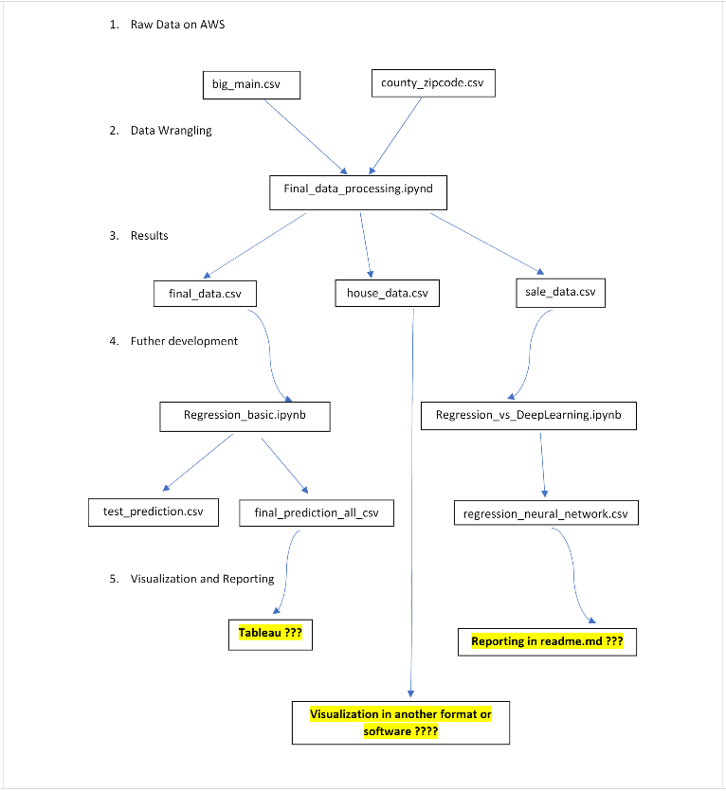
Final ETL Process
Sri to add key point to describe the Process

Slide 4
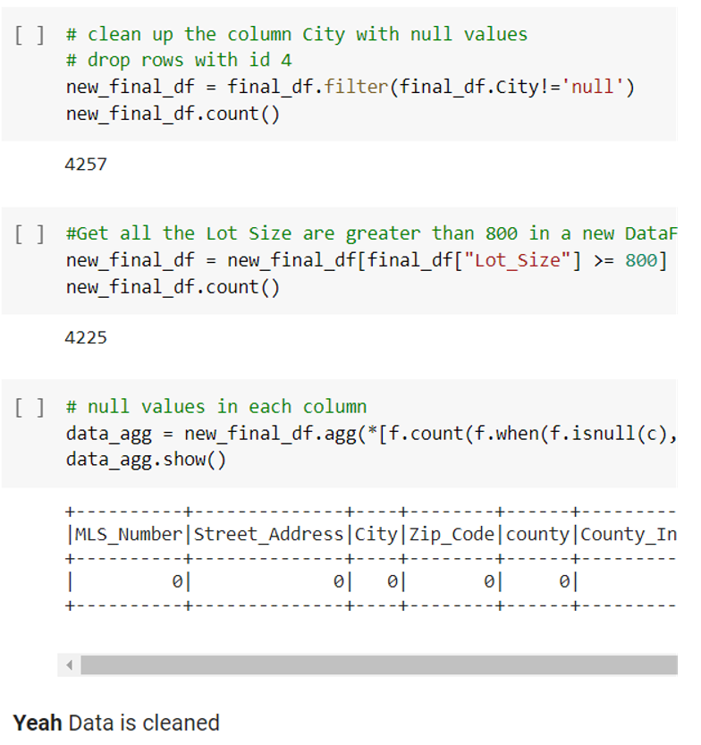
Data Processing
Dawit to add key point to describe the Process

Slide 5
Connecting the Data to DB , REGRESSION model, Deep Learning model
Trong to add key point to describe the Process

Slide 6
Connecting the Data to DB , REGRESSION model, Deep Learning model
Trong to add key point to describe the Process
2nd Slide

Slide 7
Dashboard
Data Cleanup –Phase1
Michael to add key point to describe the Process

Slide 8
Dashboard and visualization using Tableau

Slide 9
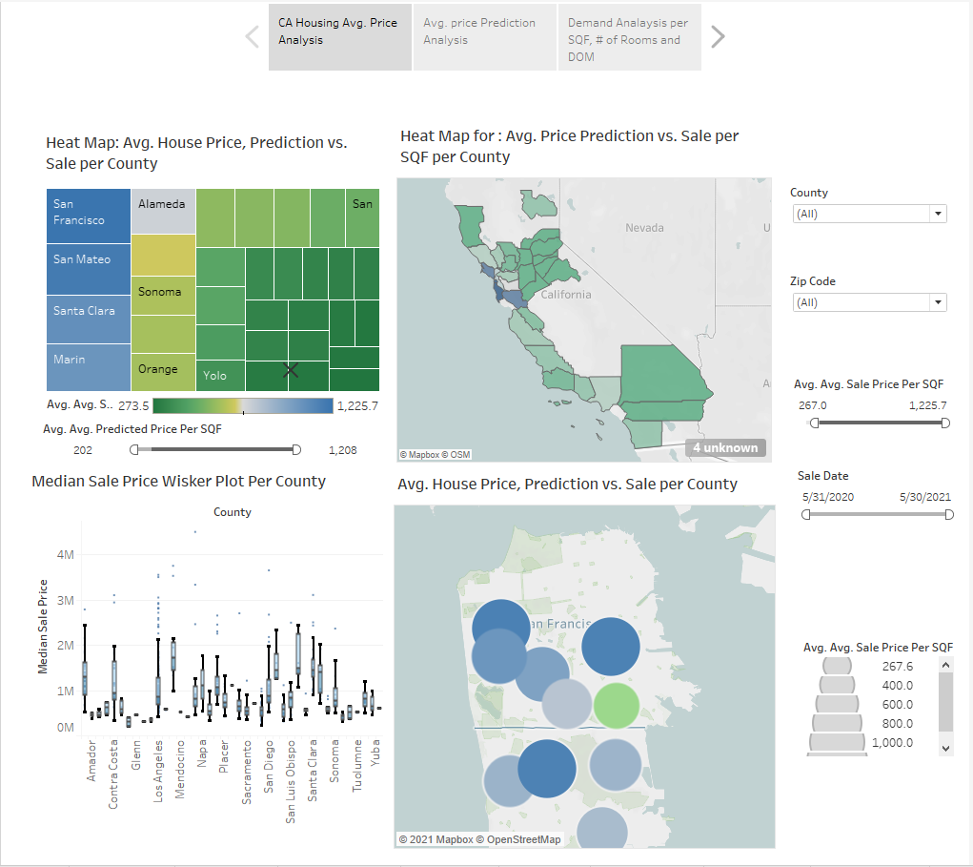
Housing Heat Maps Per Ang. Prices

Slide 10
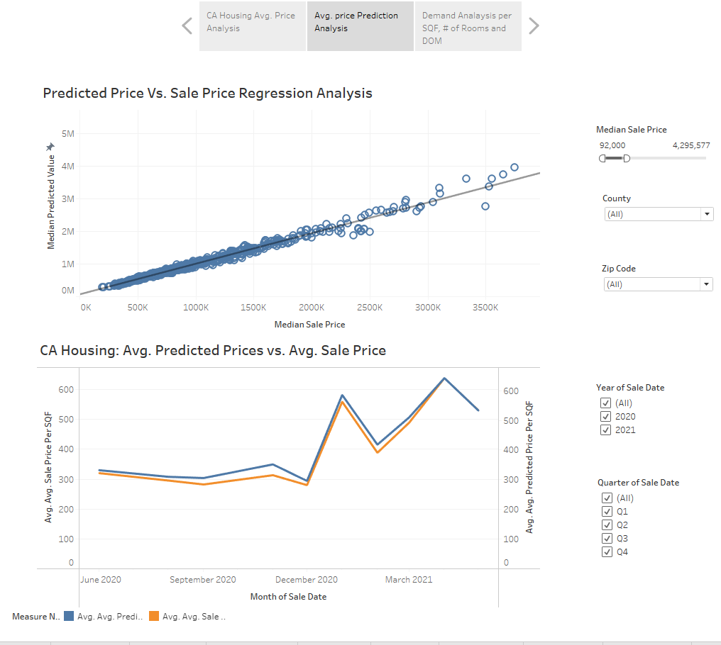
House Pricing Regression Charts

Slide 11
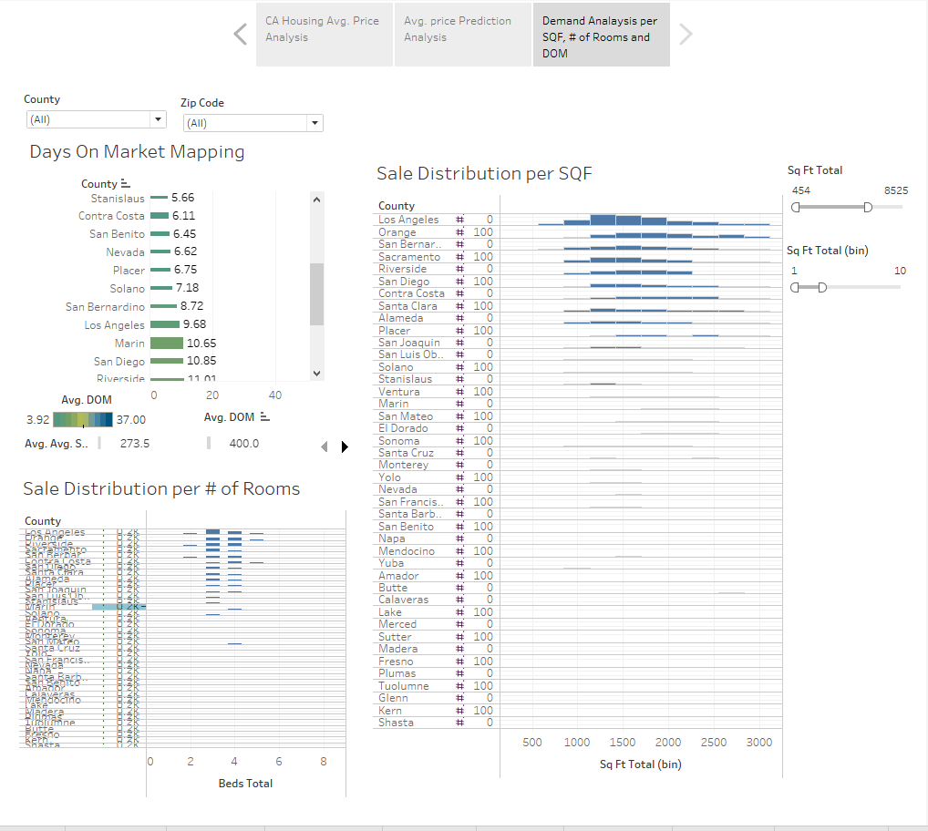
Housing Analysis Drill down
This Dashboard present :
Days on Market analysis : Avg. Number of Days from Publish to Close .
Sale Distribution Per SQF: Distribution of House sales transactions per SQF.
Sale Distribution per # of rooms shows the distribution of House sales transactions per # of rooms.

Slide 12
Recommendation for future analysis
TBD
Michael to add key point to describe the Process

Slide 13
Technologies, languages, tools, and algorithms used throughout the project
Python : Pandas, PySpark
SQLAlchemy
Postgres
Google CoLab
Google Docs.
Python ML Models: Linear regression , Keras for neural network ML Model.

Slide 14
Backup

Slide 15
Data Source
MLS Data ( https://pro.mlslistings.com/Account/Login.aspx )
The dataset includes 4340 CA housing sale records ctions for the period from 9/2017 till 7/2021. The dataset includes House Address, Zip code, House size, Lot size, Year Built, Listing Date, sale Date, Listing Price, and Sale Price.
Dataset format: CSV.
2nd Table includes dataset for mapping Zip Codes to County Names.
Dataset format: CSV .

Slide 16
Data exploration & transformation
For Data exploration we had to perform the following steps:
Clean up the Null Cells.
Update “Age” Column accordingly
We planned to build the ML per each Zip Code. but after short analysis of the Dataset , we found out that there is no enough records to Run ML Model at the Zip code level. The team decided to uplevel the analysis to the county level.
Dawit and Troung to add the ETL flow that each one put together to transform the Data .

Slide 17
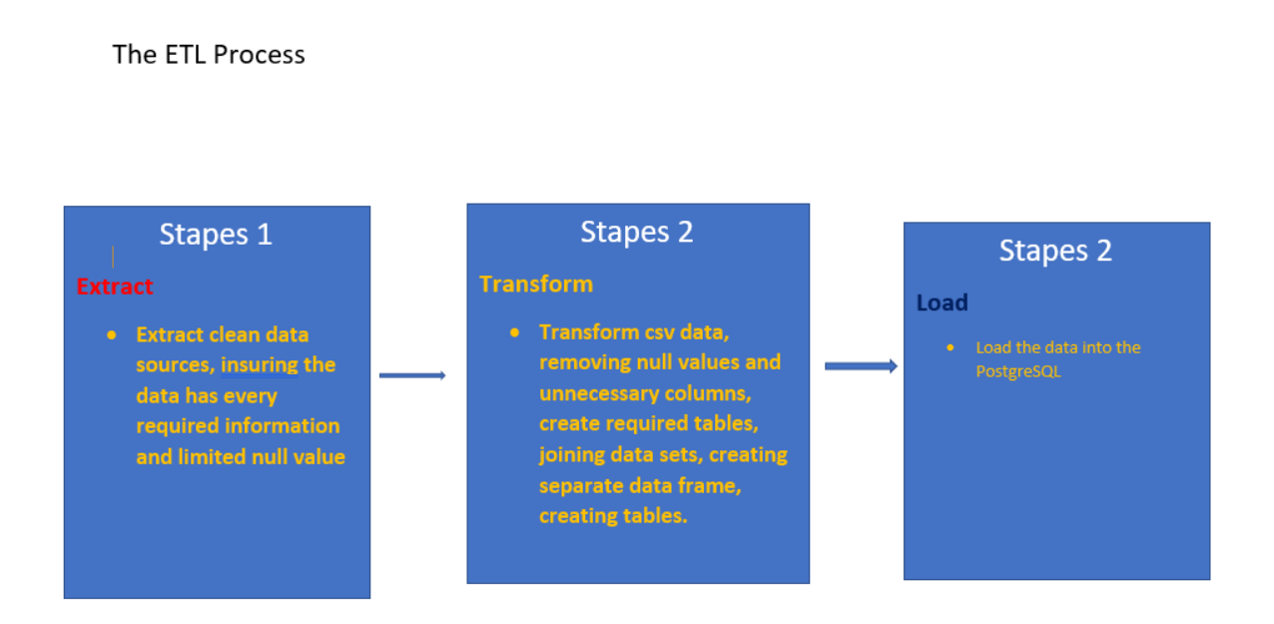
Initial Etl process

Slide 18
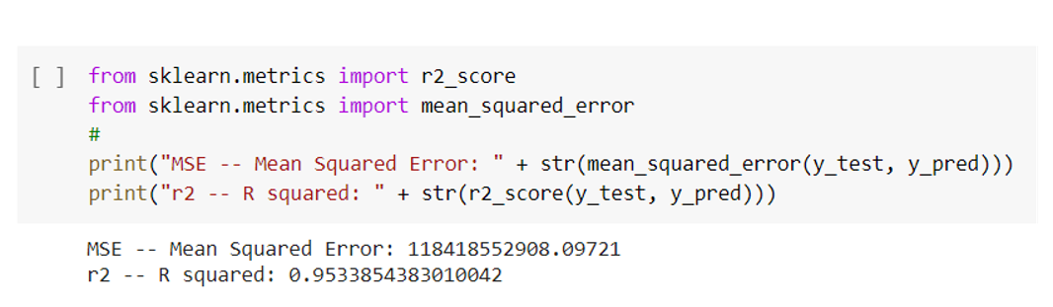
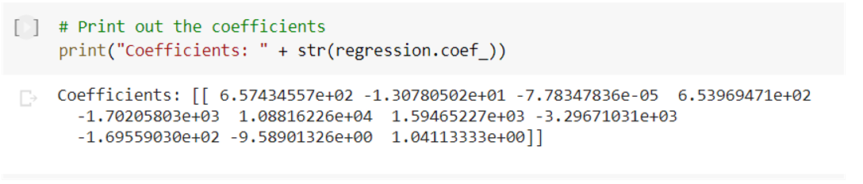
REGRESSION model
Run ML Linear regression using sklearn model

Slide 19
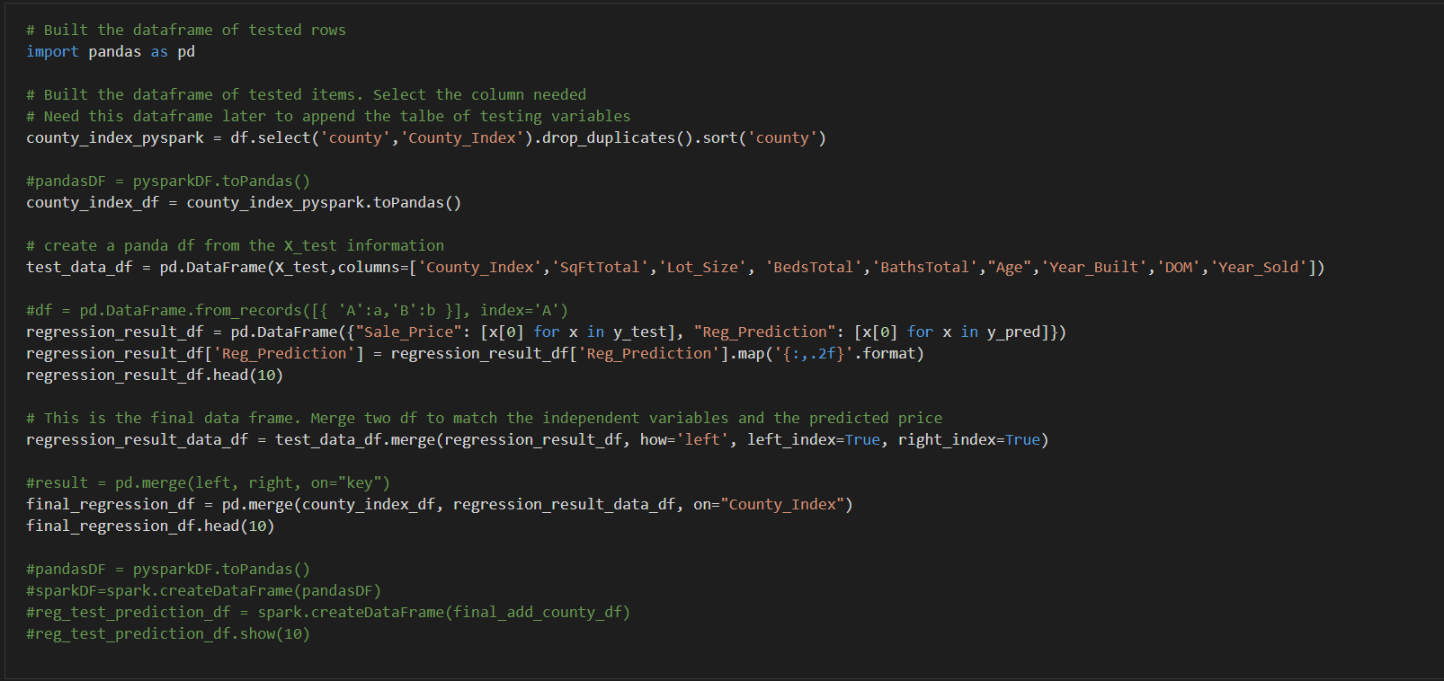
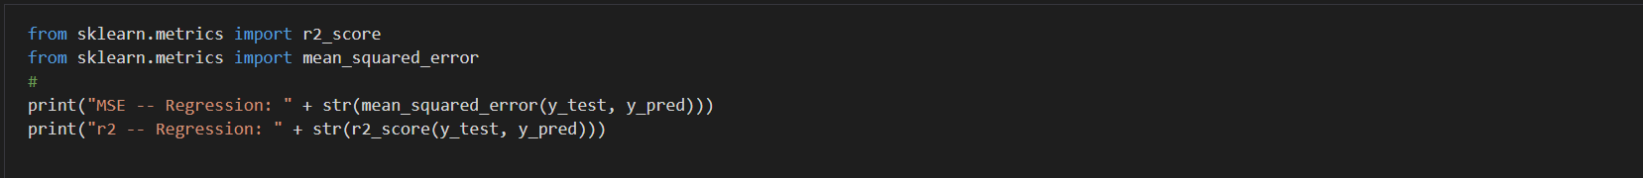
REGRESSION mODEL
Run ML Linear regression using sklearn model

Slide 20
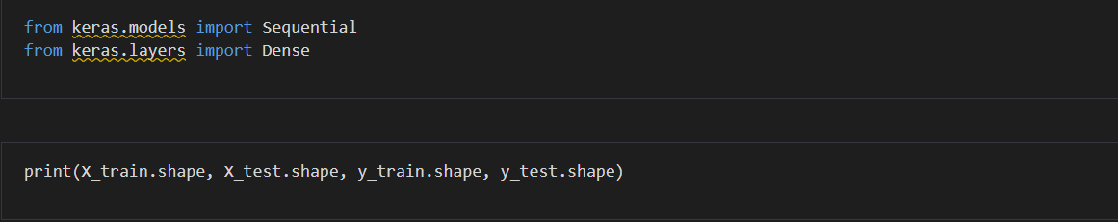
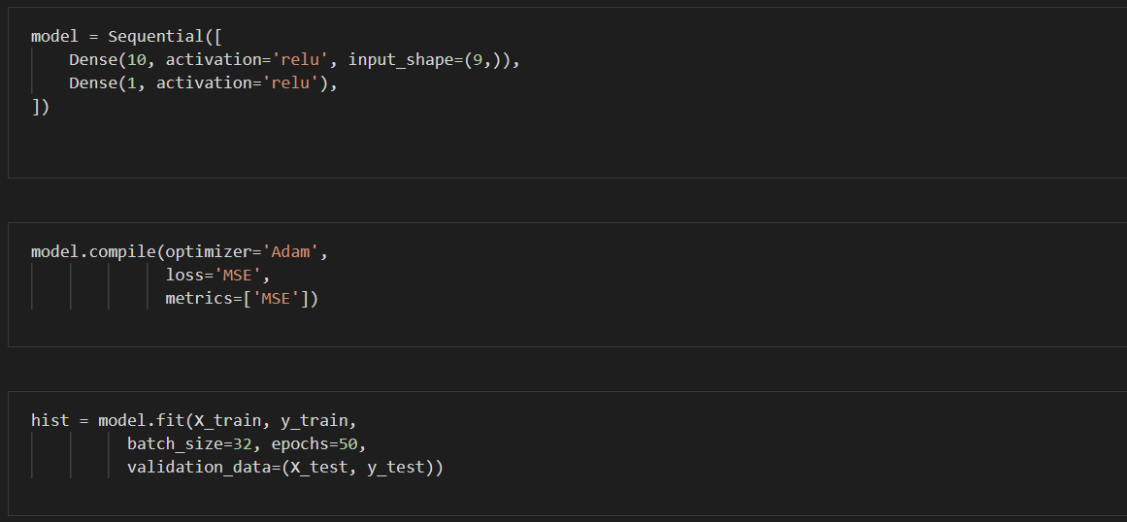
Deep Learning model
Run ML Neural Network DL ML Model

Slide 21
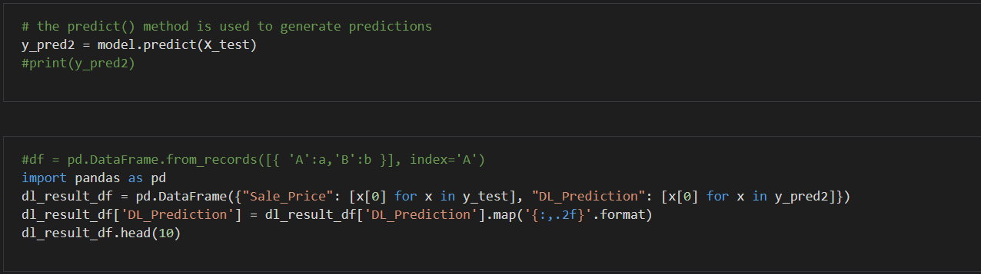
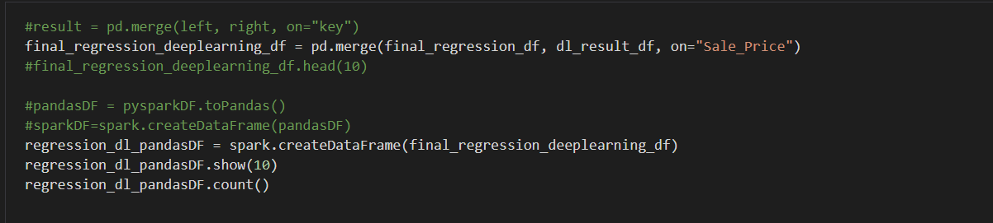
Deep Learning model
Run ML Neural Network DL ML Model - Cont

